Slide 1
Robotic Identification of Kinesthetic Deficits After Stroke
Semrau et al., 2013
Duncan Tulimieri

Slide 2
Introduction
Proprioception
Position sense – static
Kinesthesia – dynamic
Proprioception impaired in ~50-60% individuals after stroke
Clinical tools (poor)
Robots provide a promising approach
Accuracy, precision, continuous

Slide 3
Introduction
~50 % of individuals post-stroke have position sense deficits
?? % of individuals post-stroke have kinesthetic deficits
Hard to quantify using current tools
Hypothesis: stroke may result in significant kinesthetic deficits that can be reliably quantified using robotic technology

Slide 4
Methods
Subjects
Inclusion (stroke):
First onset, clinically diagnosed unilateral stroke, understand task instructions
Exclusion (stroke):
Visuospatial neglect, significant active medical issues (angina, uncontrolled hypertension, respiratory distress), bilateral stroke, other neurological diagnoses, significant upper body injuries

Slide 5
Methods
Clinical Assessments
Edinburgh Handedness Inventory
Chedoke-McMaster Stroke Assessment Impaired Inventory for Arm and Hand
Purdue Peg Board
Thumb Localizing Test
Behavioral Inattention Test
Functional Independence Measure
No significant difference between differences for left and right affected individuals

Slide 6
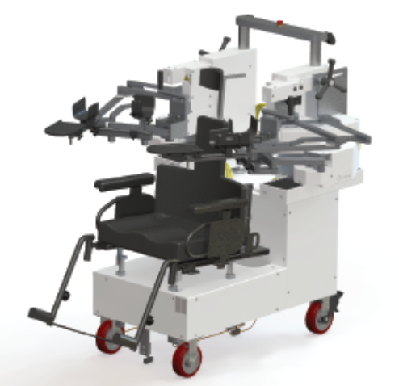
Methods
Kinesthesia Task
KINARM exoskeleton
Robot move arm (ATBA) to 1 of 3 locations
Subject see target and hand position, move to target (nATBA)
* Trial start *
Hand cursors extinguished
Random time interval (1500+/- 250 ms)
Robot move arm (ATBA) to 1 of 2 locations @ 0.28 m/s
20 cm
As soon as feel movement, mirror match to best of their ability with (nATBA)

Slide 7
Methods
Kinesthesia Task
Control subjects perform with both arms
Stroke – robot move more affected, mirror match with less affected
36 total movements
Move within 10s of ATBA movement
Non-movement trial

Slide 8
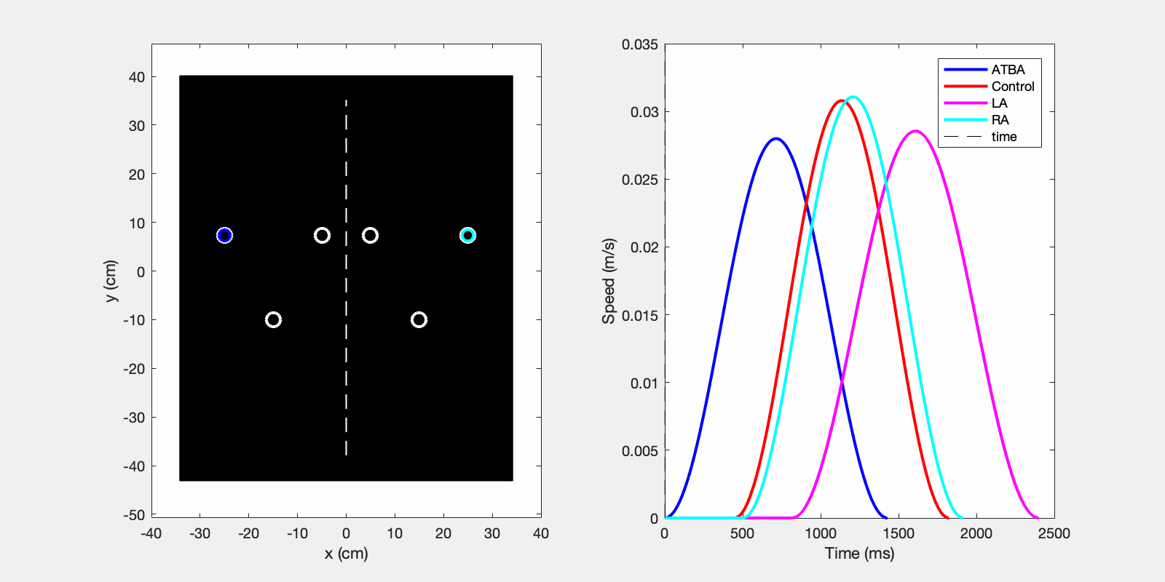
Methods
Kinesthesia Task
Notes:
Need MATLAB
Need to VPN
Open through downloads folder
Maybe need matlab

Slide 9
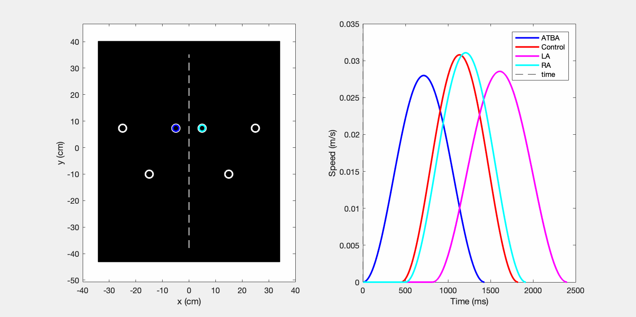
Methods
Kinesthesia Task

Slide 10
Methods
Kinesthesia Task

Slide 11
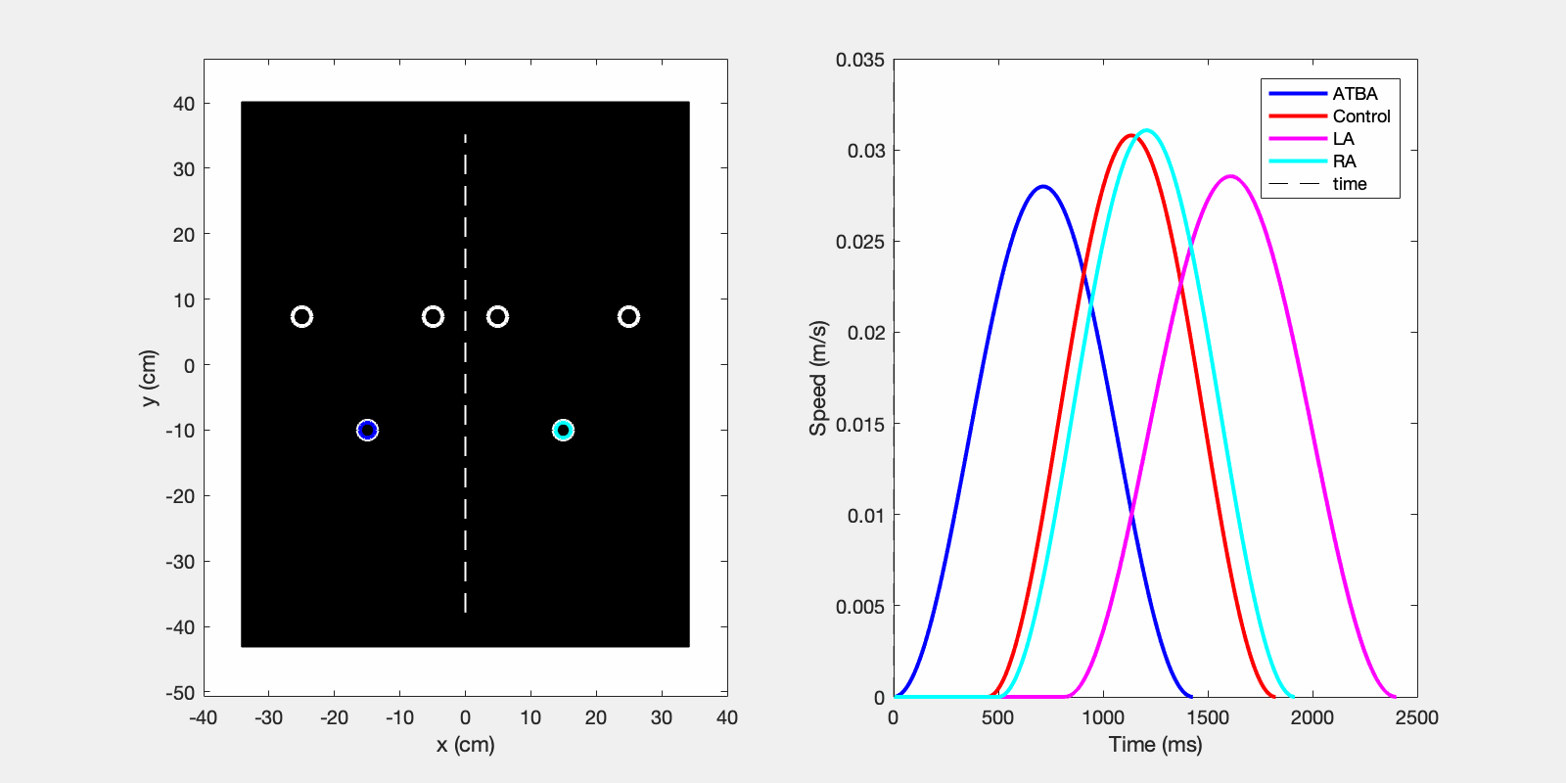
Methods
Kinesthesia Task

Slide 12
Methods
Kinesthesia Task

Slide 13
Methods
Kinesthesia Task

Slide 14
Methods
Data Analysis
Mirror transpose x-direction of active (nATBA) arm to compare between 2 limbs
Minor differences in peak speeds (+/- 0.028 m/s) and distance (+/- 0.016 cm)

Slide 15
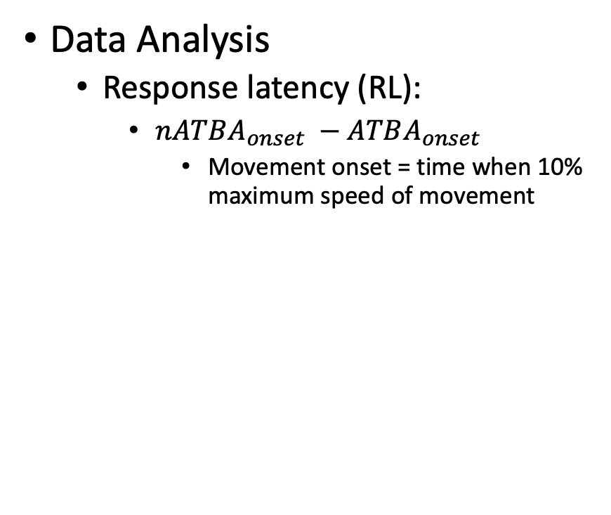
Methods
Data Analysis
Response latency (RL):
$nATBA_{onset} −ATBA_{onset}$
Movement onset = time when 10% maximum speed of movement

Slide 16
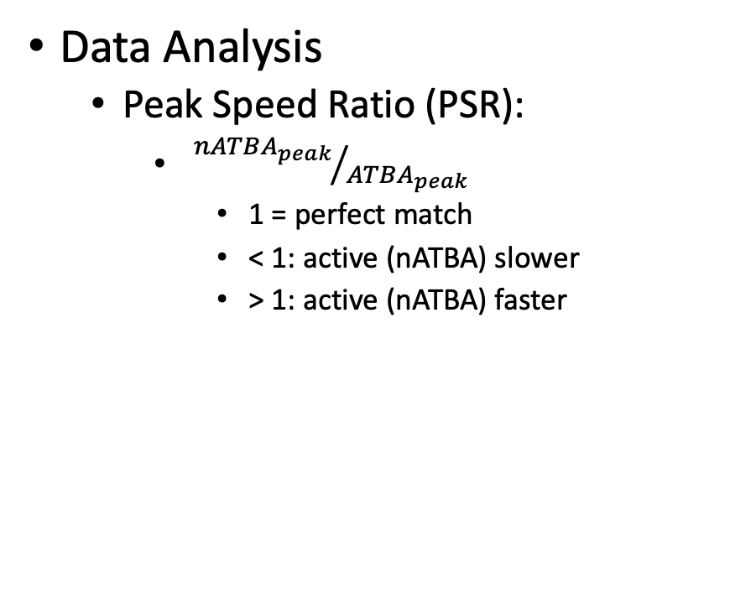
Methods
Data Analysis
Peak Speed Ratio (PSR):
${nATBA_{peak}}/{ATBA_{peak}}$
1 = perfect match
< 1: active (nATBA) slower
> 1: active (nATBA) faster

Slide 17
Methods
Data Analysis
Initial Direction Error (IDE):
Absolute angular deviation of hands at peak speeds

Slide 18
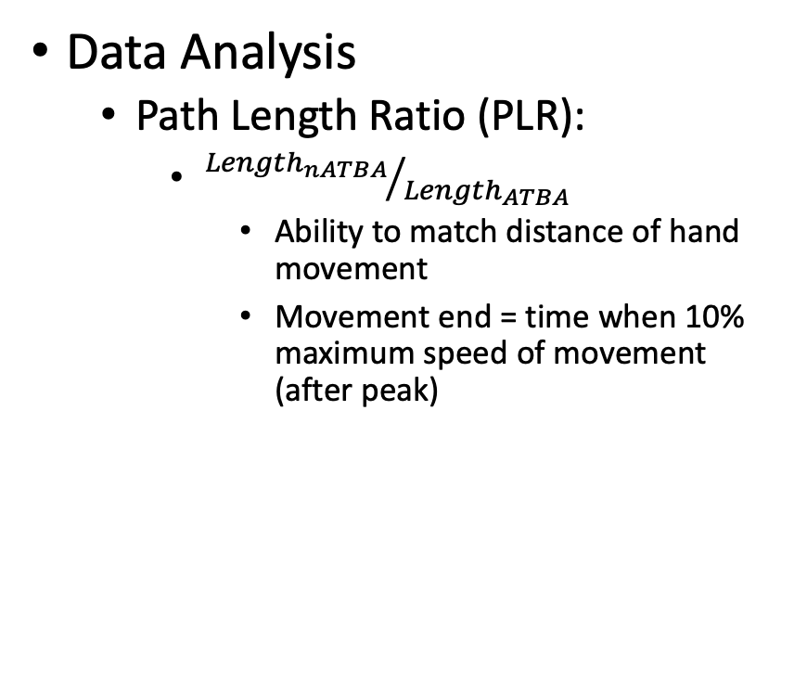
Methods
Data Analysis
Path Length Ratio (PLR):
${Length_{nATBA}}/{Length_{ATBA}}$
Ability to match distance of hand movement
Movement end = time when 10% maximum speed of movement (after peak)

Slide 19
Methods
Variability
Standard deviation of all movements
Add suffix “v”

Slide 20
Methods
Statistical Analyses
Calculate 95% confidence intervals for control subject's metrics
1-sided (IDE, RL) [0% – 95%]
2-sided (PLR, PSR) [ 2.5% - 97.5%]
Those outside 95% CI were significantly different from control
Linear regression to compare robotic and clinical
Bonferroni corrections for multiple comparisons

Slide 21
Results
Subjects
74 control
113 subject with stroke
Control
95% <= 1 non-movement
LA
42% >= 1 non-movement
15% failed to move in >25% of trials
RA
29% >= 1 non-movement
14% failed to move in > 25% of trials

Slide 22
Results
Response Latency
Mean
47% LA outside normative range
20% RA outside normative range
Variability
42% LA outside normative range
22% RA outside normative range

Slide 23
Results

Slide 24
Results

Slide 25
Results
Peak Speed Ratio
Mean
32% LA outside normative range
27% RA outside normative range
Variability
44% LA outside normative range
39% RA outside normative range

Slide 26
Results
Initial Direction Error
Mean
69% LA outside normative range
49% RA outside normative range
Variability
55% LA outside normative range
26% RA outside normative range

Slide 27
Results

Slide 28
Results

Slide 29
Results
Path Length Ratio
Mean
42% LA outside normative range
31% RA outside normative range
Variability
56% LA outside normative range
37% RA outside normative range

Slide 30
Results
Parameter Summary
5% control outside normative range for > 2 parameters
71% LA & 49% RA outside normative range for >= 3 parameters

Slide 31
Results
Clinical and Anatomic Significance
Nearly all parameters significantly correlated with FIM and FIM motor sub-score
IDE and IDEv significant predictor of poor performance on all clinical measures evaluated
Subjects that failed kinesthesia performed significantly worse on clinical tests
Significantly impaired kinesthesia in 76% of right MCA and 49% left MCA

Slide 32
Discussion
Robotic Quantification of Kinesthesia
Position matching paradigm
Ipsilesional deficits
Impaired interhemespheric transfer

Slide 33
Discussion
Relationship of Robotic Measures to Clinical Scores
Kinesthetic impaired could contribute to poor clinical score
Significantly related to: FIM, CMSA
IDE (LA and RA) and IDEv (LA) related to nearly all clinical measures
Correlations most likely due to contribution of significant sensory deficit to the overall level of functional impairment seen in individuals with stroke

Slide 34
Discussion
Differences in LA and RA Strokes
Clinical measures
No significant difference between severity of stroke between 2 groups in:
FIM, CMSA, and PPB
Robot measures
17% more LA subjects impaired compared to RA
Right hemisphere dominance for kinesthetic information
Lateralization ?

Slide 35
Discussion
Clinical Use of Measuring Kinesthetic Deficits
61% of those with stroke had significant deficits in kinesthesia
Clinical measures have difficulty differentiating between motor and sensory deficits
How to train kinesthesia ?

Slide 36
Conclusion / Next Steps
What about position sense for these same people?
What about more speeds than just 0.28 m/s?
What about more directions than just 3?
What about more distances than just 20 cm?

